Slide 1
R
Linear Regression

Slide 2
Linear regression is used to predict the value of an outcome variable Y based on one or more input predictor variables X.
Find – Y
From X1,X2, ..Xn
Y = β₁ + β₂X + ϵ

Slide 3
The aim is to establish a linear relationship (a mathematical formula) between the predictor variable(s) and the response variable, so that, we can use this formula to estimate the value of the response Y, when only the predictors (Xs) values are known.
Predictor Variable ( Xs)
Response Variable

Slide 4
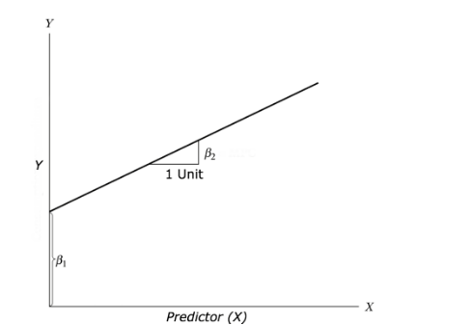

Slide 5
Graphical Analysis
Scatter plot:
Box plot:
Density plot:

Slide 6
head(cars)
Plot Speed vs Dist
scatter.smooth(x=cars$speed, y=cars$dist, main="Dist ~ Speed")

Slide 7
BoxPlot – Check for outliers
> par(mfrow=c(1, 2)) # divide graph area in 2 columns
> boxplot(cars$speed, main="Speed", sub=paste("Outlier rows: ", boxplot.stats(cars$speed)$out))
> boxplot(cars$dist, main="Distance", sub=paste("Outlier rows: ", boxplot.stats(cars$dist)$out)) # box plot for 'distance'
>

Slide 8
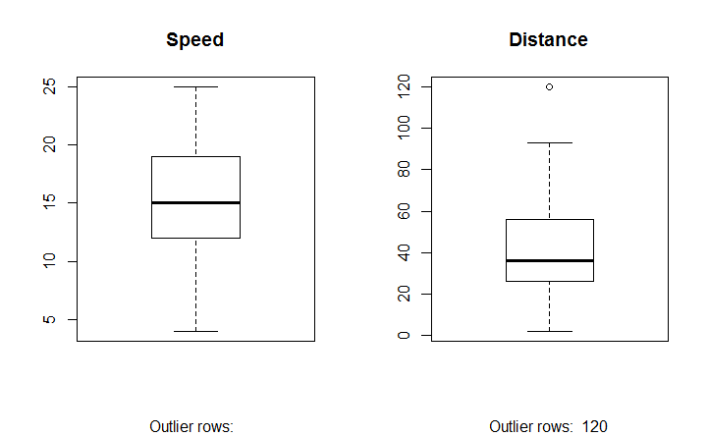

Slide 9
Density plot
Check if the response variable is close to normality

Slide 10
Density, polygon
library(e1071)
par(mfrow=c(1, 2)) # divide graph area in 2 columns
plot(density(cars$speed), main="Density Plot: Speed", ylab="Frequency", sub=paste("Skewness:", round(e1071::skewness(cars$speed), 2)))
# density plot for 'speed'
polygon(density(cars$speed), col="red")
plot(density(cars$dist), main="Density Plot: Distance", ylab="Frequency", sub=paste("Skewness:", round(e1071::skewness(cars$dist), 2)))
# density plot for 'dist'
polygon(density(cars$dist), col="red")

Slide 11
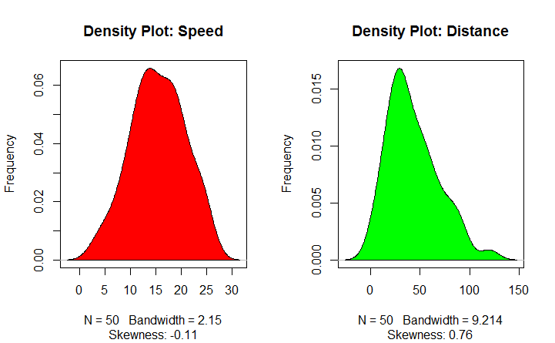

Slide 12
correlation
cor(cars$speed, cars$dist)
0.8068949

Slide 13
lm(formula, data)
> linearMod <- lm(dist ~ speed, data=cars)
> print(linearMod)
Call:
lm(formula = dist ~ speed, data = cars)
Coefficients:
(Intercept) speed
-17.579 3.932
> summary(linearMod)

Slide 14
Find distance from speed
Intercept: -17.579, speed: 3.932 These are also called the beta coefficients. In other words,
dist = Intercept + (β ∗ speed) => dist = −17.579 + 3.932∗speed

Slide 15
P-value
T- value
F Value
R-Squared and Adj R-Squared

Slide 16
The actual information in a data is the total variation it contains, remember?. What R-Squared tells us is the proportion of variation in the dependent (response) variable that has been explained by this model.
High RSS is good model, ofcourse not always !!

Slide 17
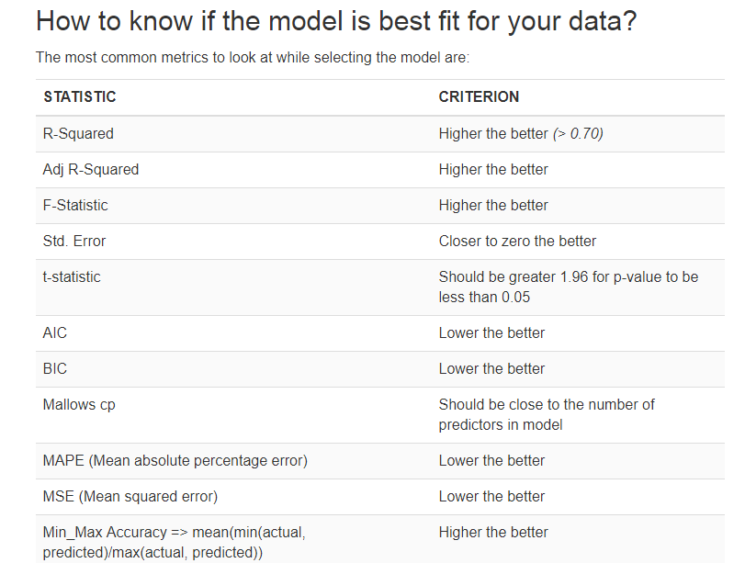

Slide 18
Predicting Linear Models
After Model, one has to test data with equation

Slide 19
# Create Training and Test data -
set.seed(100) # setting seed to reproduce results of random sampling
trainingRowIndex <- sample(1:nrow(cars), 0.8*nrow(cars)) # row indices for training data
trainingData <- cars[trainingRowIndex, ] # model training data
testData <- cars[-trainingRowIndex, ] # test data
# Build the model on training data -
lmMod <- lm(dist ~ speed, data=trainingData) # build the model
distPred <- predict(lmMod, testData) # predict distance
summary (lmMod) # model summary

Slide 20
> summary (lmMod)
Call:
lm(formula = dist ~ speed, data = trainingData)
Residuals:
Min 1Q Median 3Q Max
-23.350 -10.771 -2.137 9.255 42.231
Coefficients:
Estimate Std. Error t value Pr(>|t|)
(Intercept) -22.657 7.999 -2.833 0.00735 **
speed 4.316 0.487 8.863 8.73e-11 ***
---
Signif. codes: 0 ‘***’ 0.001 ‘**’ 0.01 ‘*’ 0.05 ‘.’ 0.1 ‘ ’ 1
Residual standard error: 15.84 on 38 degrees of freedom
Multiple R-squared: 0.674, Adjusted R-squared: 0.6654
F-statistic: 78.56 on 1 and 38 DF, p-value: 8.734e-11
> print(distPred)
1 4 8 20 26 31 37 39 40 42
-5.392776 7.555787 20.504349 37.769100 42.085287 50.717663 59.350038 63.666225 63.666225 63.666225
>

Slide 21
# Calculate prediction accuracy and error rates
actuals_preds <- data.frame(cbind(actuals=testData$dist, predicteds=distPred)) # make actuals_predicteds dataframe.
correlation_accuracy <- cor(actuals_preds) # 82.7%
head(actuals_preds)

Slide 22
> min_max_accuracy <- mean(apply(actuals_preds, 1, min) / apply(actuals_preds, 1, max))
> print(min_max_accuracy)
[1] 0.3800489
> mape <- mean(abs((actuals_preds$predicteds - actuals_preds$actuals))/actuals_preds$actuals)

Slide 23
library(DAAG)
cvResults <- suppressWarnings(CVlm(data=cars, form.lm=dist ~ speed, m=5, dots=FALSE, seed=29, legend.pos="topleft", printit=FALSE))
attr(cvResults, 'ms')

Slide 24
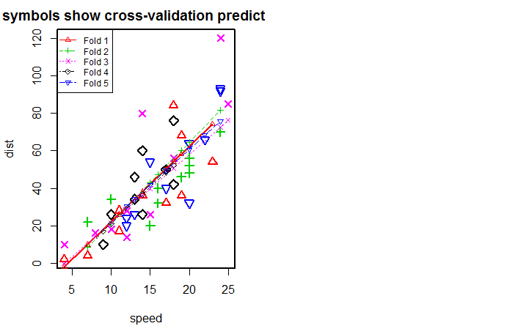

Slide 25
CVlm()
Cross-Validation For Linear Regression
library(DAAG)
cvResults <- suppressWarnings(CVlm(data=cars, form.lm=dist ~ speed, m=5, dots=FALSE, seed=29, legend.pos="topleft", printit=FALSE));
# performs the CV
attr(cvResults, 'ms') # => 251.2783 mean squared error

Slide 26
> plot(dist ~ speed,col = "blue",main = "Height & Weight Regression")
> abline(lm(dist~speed))

Slide 27
Single
Multiple

